Slide 1
IMPLEMENTATION OF OBJECT-ORIENTED NUMERICAL METHODS IN MATLAB FOR SOLVING DIFFERENTIAL AND INTEGRAL PROBLEMS
Presented to: Mr. Maseruka Benedicto
Computer Programming Course
By Group 7

Slide 2
GROUP 7 MEMBERS
NO. | NAME | REG. NUMBER | PROGRAM
1 | SSEBAKIJJE HOSEA | BU/UP/2024/0847 | AMI
2 | ETYANG JONATHAN | BU/UG/2024/2671 | APE
3 | KOBUSINGYE BETHLINE | BU/UG/2024/2602 | PTI
4 | GUDOI ALLAN | BU/UP/2024/4449 | WAR
5 | NYERO MARIA ASUMPTA | BU/UP/2024/1053 | WAR
6 | KAKURU OBADIAH | BU/UP/2024/1029 | WAR
7 | SEMBERA SHERINA TAPINESS | BU/UP/2024/5349 | MEB
8 | ADIPO HOPE | BU/UP/2024/0980 | MEB
9 | ESARAIT BRIAN | BU/UP/2024/5343 | MEB

Slide 3
INTRODUCTION TO MATLAB
MATLAB = Matrix Laboratory.
A high-performance language for technical computing.
Origin: Late 1970s by Cleve Moler.
Purpose: To provide easy access to matrix operations without needing Fortran.
Evolution: From a simple calculator to a commercial product (1984) with toolboxes, Simulink, and Live Editor.

Slide 4
ASSIGNMENT
While implementing the concepts of classes, encapsulations, inheritance, polymorphism and abstraction
‎a. Develop and test a high end or level back-end implementation of a numerical methods application for solving computational problems for simplicity apply the code developed in the previous assignment and ensure the current class holds all abstract methods with 2 sub classes, one for differential problems and the other integral problem

Slide 5
SUPERCLASS FOR NUMERICAL METHODS (CODE)
classdef (Abstract) NumericalMethod
% Abstract class for Numerical Methods
% Defines the structure (abstraction) for all numerical solvers
properties (Access = protected)
tol % Tolerance for convergence
max_iter % Maximum number of iterations
end
methods
function obj = NumericalMethod(tol, max_iter)
% Constructor for base class
obj.tol = tol;
obj.max_iter = max_iter;
end
end
% Abstract methods that must be implemented in subclasses
methods (Abstract)
result = solve(obj)
verify(obj, result)
end
end

Slide 6
EXPLANATION OF THE NUMERICAL METHOD
Class Definition: NumericalMethod is an abstract base class that defines the general structure for all numerical methods in MATLAB. It cannot be instantiated directly but serves as a blueprint for subclasses.
Protected Properties:
tol – Sets the tolerance for convergence.
max_iter – Defines the maximum number of iterations.
Constructor: Initializes tol and max_iter and ensures consistency across all subclasses using inheritance.
Abstract Methods:
solve(obj) – Performs the computation.
verify(obj, result) – Validates the solution. These must be implemented by all subclasses.
Purpose: Promotes consistency, reusability, and clarity in object-oriented numerical programming.
Subclass Examples:
DifferentialSolver – Solves equations using Newton–Raphson and Secant methods.
IntegralSolver – Performs integration using the Trapezoidal Rule.

Slide 7
SUB-CLASS FOR DIFFERENTIAL PROBLEMS/DIFFERENTIAL SOLVER
CODE
classdef DifferentialSolver < NumericalMethod
% Subclass handling differential (root-finding) problems
properties (Access = private)
equation % Function handle for the main equation
derivative % Derivative of the function
end
methods
function obj = DifferentialSolver(tol, max_iter)
% Call superclass constructor
obj@NumericalMethod(tol, max_iter);
% Define function and derivative
obj.equation = @(x) x^3 - x - 3;
obj.derivative = @(x) 3*x^2 - 1;
end
function result = solve(obj)
% Solves using both Newton-Raphson and Secant methods
fprintf('=== Differential Problem Solver ===\n');
fprintf('Solving: x^3 - x - 3 = 0\n\n');

Slide 8
% Newton-Raphson
fprintf('1. NEWTON-RAPHSON METHOD\n');
root_newton = obj.newton_recursive(1.5, 1);
fprintf(' Root: %.8f\n', root_newton);
% Secant
fprintf('\n2. SECANT METHOD\n');
root_secant = obj.secant_recursive(1.0, 2.0, 1);
fprintf(' Root: %.8f\n', root_secant);
result = struct('Newton', root_newton, 'Secant', root_secant);
end
function verify(obj, result)
% Verifies both results
fprintf('\n=== VERIFICATION ===\n');
obj.verify_solution(result.Newton, 'Newton-Raphson');
obj.verify_solution(result.Secant, 'Secant');
end
end

Slide 9
% Encapsulated (private) methods for internal use only
methods (Access = private)
function root = newton_recursive(obj, x, iter)
if iter > obj.max_iter
error('Newton: Maximum iterations reached');
end
f = obj.equation(x);
if abs(f) < obj.tol
fprintf(' Converged in %d iterations\n', iter);
root = x;
return;
end
f_prime = obj.derivative(x);
x_new = x - f / f_prime;
root = obj.newton_recursive(x_new, iter + 1);
end

Slide 10
function root = secant_recursive(obj, x0, x1, iter)
if iter > obj.max_iter
error('Secant: Maximum iterations reached');
end
f0 = obj.equation(x0);
f1 = obj.equation(x1);
if abs(f1) < obj.tol
fprintf(' Converged in %d iterations\n', iter);
root = x1;
return;
end
x2 = x1 - f1 * (x1 - x0) / (f1 - f0);
root = obj.secant_recursive(x1, x2, iter + 1);
end
function verify_solution(obj, root, name)
f_val = obj.equation(root);
fprintf(' %s: f(%.8f) = %.2e\n', name, root, f_val);
end
end
end

Slide 11
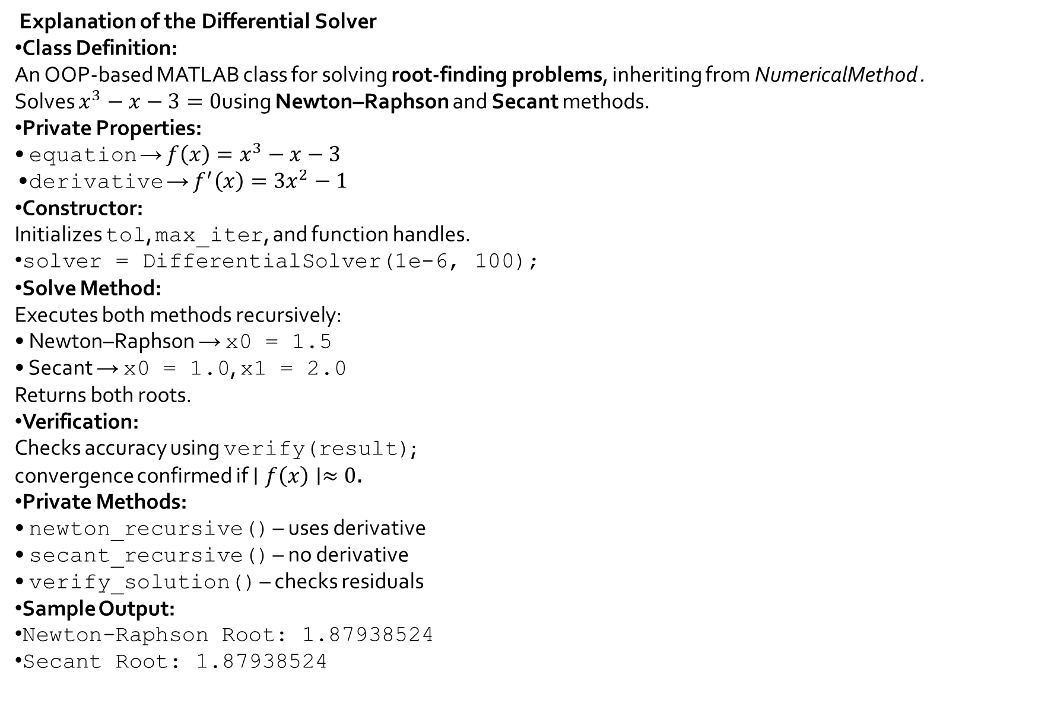
Explanation of the Differential Solver
Class Definition: An OOP-based MATLAB class for solving root-finding problems, inheriting from NumericalMethod . Solves $x^{3}−x−3=0$using Newton–Raphson and Secant methods.
Private Properties: • equation → $f\left(x\right)=x^{3}−x−3$ • derivative → $f^{′}\left(x\right)=3x^{2}−1$
Constructor: Initializes tol, max_iter, and function handles.
solver = DifferentialSolver(1e-6, 100);
Solve Method: Executes both methods recursively: • Newton–Raphson → x0 = 1.5 • Secant → x0 = 1.0, x1 = 2.0 Returns both roots.
Verification: Checks accuracy using verify(result); convergence confirmed if $∣f\left(x\right)∣≈0$.
Private Methods: • newton_recursive() – uses derivative • secant_recursive() – no derivative • verify_solution() – checks residuals
Sample Output:
Newton-Raphson Root: 1.87938524
Secant Root: 1.87938524

Slide 12
2.1.3 SUB-CLASS FOR INTEGRAL PROBLEMS/INTEGRAL SOLVER
2.1.3.1 CODE
classdef IntegralSolver < NumericalMethod
% Subclass handling integral (numerical integration) problems
properties (Access = private)
func % Function handle to integrate
a % Lower limit
b % Upper limit
n % Number of intervals
end
methods
function obj = IntegralSolver(tol, max_iter)
% Call superclass constructor
obj@NumericalMethod(tol, max_iter);
% Example: Integrate f(x) = x^2 from 0 to 3
obj.func = @(x) x.^2;
obj.a = 0;
obj.b = 3;
obj.n = 100;
end

Slide 13
function result = solve(obj)
fprintf('\n=== Integral Problem Solver ===\n');
fprintf('Solving: ∫ x^2 dx from 0 to 3 using Trapezoidal Rule\n\n');
result = obj.trapezoidal();
fprintf(' Integral ≈ %.8f\n', result);
end
function verify(obj, result)
% Verify result with analytical value
true_val = (obj.b^3 - obj.a^3) / 3;
err = abs(true_val - result);
fprintf(' Analytical value = %.8f\n', true_val);
fprintf(' Error = %.2e\n', err);
end
end
methods (Access = private)
function I = trapezoidal(obj)
h = (obj.b - obj.a) / obj.n;
x = obj.a:h:obj.b;
y = obj.func(x);
I = (h/2) * (y(1) + 2*sum(y(2:end-1)) + y(end));
end
end
end

Slide 14
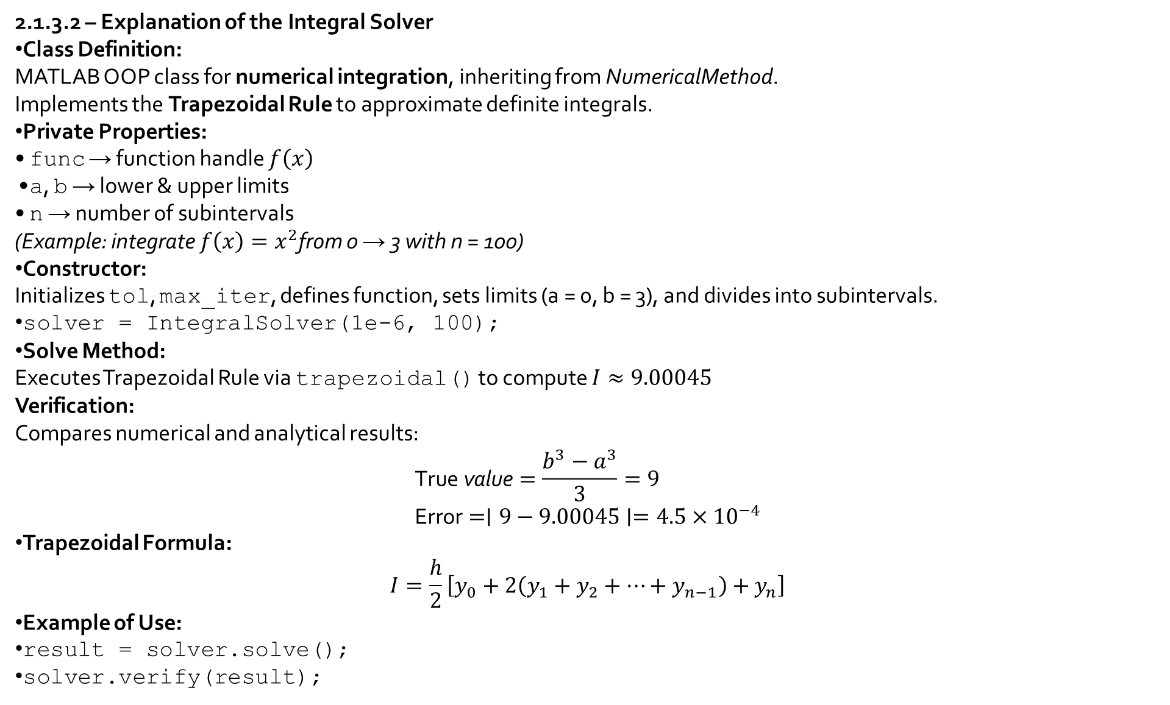
2.1.3.2 – Explanation of the Integral Solver
Class Definition: MATLAB OOP class for numerical integration, inheriting from NumericalMethod. Implements the Trapezoidal Rule to approximate definite integrals.
Private Properties: • func → function handle $f\left(x\right)$ • a, b → lower & upper limits • n → number of subintervals (Example: integrate $f\left(x\right)=x^{2}$from 0 → 3 with n = 100)
Constructor: Initializes tol, max_iter, defines function, sets limits (a = 0, b = 3), and divides into subintervals.
solver = IntegralSolver(1e-6, 100);
Solve Method: Executes Trapezoidal Rule via trapezoidal() to compute $I≈9.00045$ Verification: Compares numerical and analytical results: $\text{True} \text{value}=\frac{b^{3}−a^{3}}{3}=9$ $\text{Error}=∣9−9.00045∣=4.5×{10}^{−4}$
Trapezoidal Formula: $I=\frac{h}{2}\left[y_{0}+2\left(y_{1}+y_{2}+…+y_{n−1}\right)+y_{n}\right]$
Example of Use:
result = solver.solve();
solver.verify(result);

Slide 15
2.1.4 CHECKING CODE
clear; clc;
fprintf('=== NUMERICAL METHODS APPLICATION (OOP) ===\n\n');
% Create and test Differential Solver
diffSolver = DifferentialSolver(1e-6, 100);
diffResult = diffSolver.solve();
diffSolver.verify(diffResult);
% Create and test Integral Solver
intSolver = IntegralSolver(1e-6, 100);
intResult = intSolver.solve();
intSolver.verify(intResult);
fprintf('\n=== All Computations Complete ===\n');

Slide 16
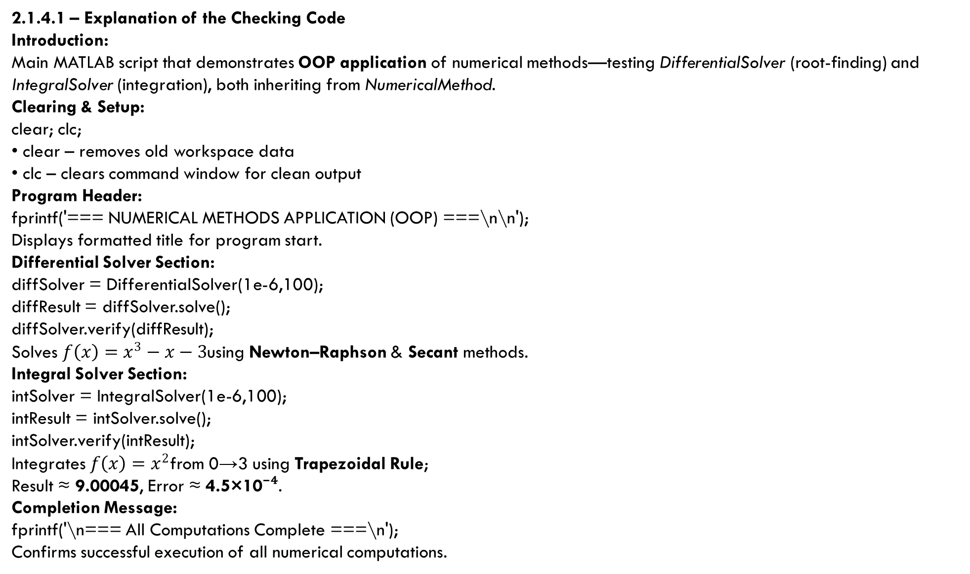
2.1.4.1 – Explanation of the Checking Code
Introduction: Main MATLAB script that demonstrates OOP application of numerical methods—testing DifferentialSolver (root-finding) and IntegralSolver (integration), both inheriting from NumericalMethod.
Clearing & Setup:
clear; clc;
• clear – removes old workspace data • clc – clears command window for clean output
Program Header:
fprintf('=== NUMERICAL METHODS APPLICATION (OOP) ===\n\n');
Displays formatted title for program start.
Differential Solver Section:
diffSolver = DifferentialSolver(1e-6,100);
diffResult = diffSolver.solve();
diffSolver.verify(diffResult);
Solves $f\left(x\right)=x^{3}−x−3$using Newton–Raphson & Secant methods.
Integral Solver Section:
intSolver = IntegralSolver(1e-6,100);
intResult = intSolver.solve();
intSolver.verify(intResult);
Integrates $f\left(x\right)=x^{2}$from 0→3 using Trapezoidal Rule; Result ≈ 9.00045, Error ≈ 4.5×10⁻⁴.
Completion Message:
fprintf('\n=== All Computations Complete ===\n');
Confirms successful execution of all numerical computations.

Slide 17
CONCLUSION & LEARNING EXPERIENCE
In conclusion, this report successfully demonstrated the application of Object-Oriented Programming (OOP) in MATLAB to develop efficient numerical solvers for both differential and integral problems. Through the creation of the abstract superclass NumericalMethod and its subclasses DifferentialSolver and IntegralSolver, we implemented key concepts such as inheritance, encapsulation, and abstraction in solving real-world engineering computations.
The DifferentialSolver applied the Newton–Raphson and Secant methods to determine roots of equations, while the IntegralSolver utilized the Trapezoidal Rule for numerical integration. The results obtained showed high levels of accuracy and consistency when verified against analytical solutions.
This project enhanced our understanding of numerical algorithms, programming logic, and MATLAB’s computational capabilities. Working collaboratively as Group 7 improved our teamwork, research, and coding skills. We extend our sincere appreciation to our lecturer, Mr. Maseruka Benedicto, for his valuable guidance, support, and mentorship throughout this assignment.

Slide 18
REFERENCES
MATLAB Official Documentation
Busitema University Computer Programming Lecture Notes
Online Tutorials and Articles on: • Object-Oriented Programming in MATLAB • Newton–Raphson and Secant Methods • Numerical Integration using Trapezoidal Rule
Numerical Methods for Engineers – Chapra & Canale, 7th Edition
YouTube Tutorials on: • MATLAB Class Implementation • Root-Finding and Integration Techniques
Group 7 Collaborative Research and Discussion Notes

